Slide 1
Mid-module Review
MED676 Bioinformatics Module
Dennis Wang

Slide 2
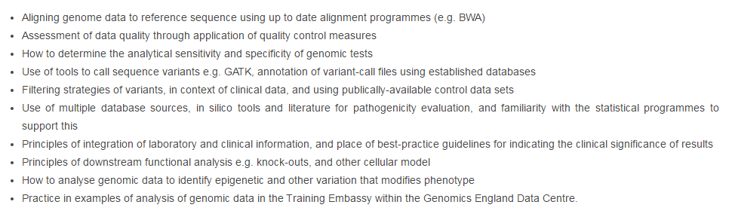
Outline of Syllabus
Online and Monday
Tuesday
Online and Tuesday
Online and Tuesday
Wednesday
Monday-Thursday
Wednesday
Thursday
Wednesday and Thursday
Monday
Data resources and Statistics
GeL
Sensitivity and Specificity
Best practices
Sequence
Variants
Annotations
Interpretations
Galaxy + GATK tools
Functional and phenotypic
Quality Control

Slide 3
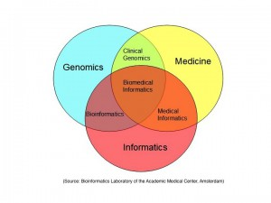
What is Bioinformatics?
Genomics
Where to find data (eg. databases)
Type (eg. file formats)
Quality
Informatics
Data storage/management (eg. Google Drive, Galaxy)
Data transformation (eg. fastq-> BAM)
Communication of information (eg. annotate and prioritize)
Many technical details and issues, but focus on the concepts and approaches!
Notes:
When we merge the two, we interpret

Slide 4
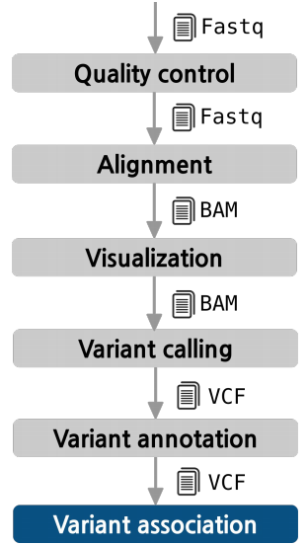
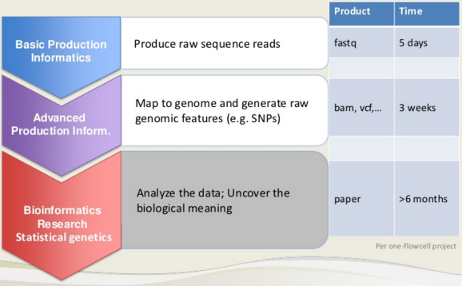
Review of Sequence -> Variant

Slide 5
Where to find data
Sequences:
EBI ENA - http://www.ebi.ac.uk/ena
TCGA - https://cancergenome.nih.gov/ and http://www.cbioportal.org/
Variants:
ExAC - http://exac.broadinstitute.org/
dbSNP - https://www.ncbi.nlm.nih.gov/SNP/
ClinVar - https://www.ncbi.nlm.nih.gov/clinvar/
OMIM - https://www.omim.org/
Genes:
ENSEMBL - http://www.ensembl.org/index.html
UCSC Genome Browser - https://genome.ucsc.edu
Studies:
100K Genomes(Embassy) - https://emb.extge.co.uk:444/GeL/login/login.php
Framingham Heart - https://www.framinghamheartstudy.org/
East London Genes and Health - http://www.genesandhealth.org/

Slide 6
Tools
FastQC
Bowtie
There are many others that could be used
Galaxy
IGV
“Bayesian”
wANNOVAR

